Slide 1

St. Patrick’s Manor
Team SPM UTI
Irene Fraser RN BSN
Infection Control SPM

Slide 2

Tryouts / Team
• Where to start?
•Surveillance of the number of UTI’s in the facility. Reason for obtaining urines. Discussed with other facilities their policies and procedures.
•Change our mind set on when to check a urine.
•Discussed with Administration, Medical Director and Nursing Director what are goals would be and how we would obtain them.
•Our team consisted of Infection Control, Medical/Nursing Staff, Restorative Nursing and Irene Campbell NP.
•Staff Development was utilized to help create in-service.
•Needed all shifts involved.

Slide 3

Pre-Game
• Brainstormed our approach.
• Wanted to create an in-service class for the Nursing Staff.
• Utilize Handouts/visual:
•ABC’s for diagnosing urinary tract infections in LTC.
• Interact Care Path Symptoms of Urinary Tract Infections.
• Interventions before checking a urine.
• Created a role playing video on how to interact with families.

Slide 4

Attack: First Half
• Held in-services with a small presentation that included a role play situation.
• Shift to Shift exposure. Went to the nurses on all shifts to discuss the plan reducing the number of UTI’s by having an individualized approach.
• Discontinued the use of Multistix in the facility.
• Think! Nursing 101 Breaking bad habits.
• Physicians/NP’s: Prepared letter with our goals and hand outs. Medical Director discussed with Physicians.
• Attended morning report.
• Changed our Policy and Procedures.

Slide 5

Halftime
•How do we get the families and residents involved and change their mind set?
•Irene Campbell NP piloted family insert and determined an intervention was needed for the comprehension of families.
•Irene Campbell NP created a short presentation to families on UTI’s and antibiotic usage.
•Empowerment of nursing staff.
•Lingering bottle of Multistix .
•HELP! Weekend prescriber and nursing coverage.
•Refuel Up!

Slide 6
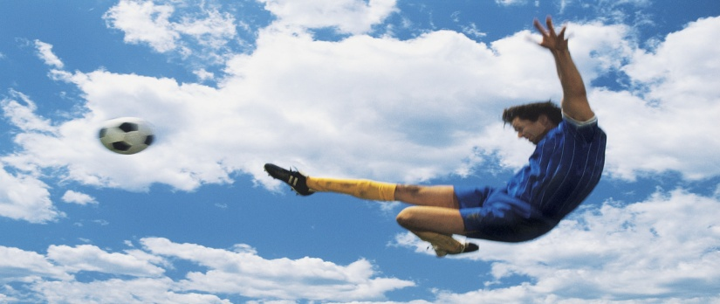
Attack: Second Half
•Continued with our attack with same approach of 1st half but……..
• We took a step back as coaches
•Few non-team players
•Encourage to document approaches/interventions
•Re-educated staff to keep things fresh
•Seal the deal!!!

Slide 7
Final Score ***** Victory!!!!
•Reduction of UTI’s in the facility
•Increased our individualized approach for each resident
•Increased staff and families knowledge
•Reduced potential for MDRO’s
•May 2012 : 21 UTI’s, 31 U/A C&S completed
•May 2013 : 7 UTI’s, 17 U/A C&S completed

